Slide 1
Module-5
Market segmentation, Targeting and Brand Positioning:
Presentation by
Dr. Basavaraj S.Kudachimath

Slide 2
Discussion Points
Concept of Market Segmentation,
Benefits, Requisites of Effective Segmentation,
Bases for Segmenting Consumer Markets,
Market Segmentation Strategies.
Types of Segmentation.
Targeting –
Bases for identifying target Customer
Target Marketing strategies,
Positioning - Meaning,
Tasks involved in Positioning.
Monitoring brands performance and positioning.
Product Differentiation Strategies.

Slide 3
What is segmentation?
Market segmentation is the process of dividing the heterogeneous market in to homogeneous sub units
The process of defining and subdividing a large homogenous market into clearly identifiable segments having similar needs, wants, or demand characteristics. Its objective is to design a marketing mix that precisely matches the expectations of customers in the targeted segment.
Few companies are big enough to supply the needs of an entire market; most must breakdown the total demand into segments and choose those that the company is best equipped to handle.

Slide 5
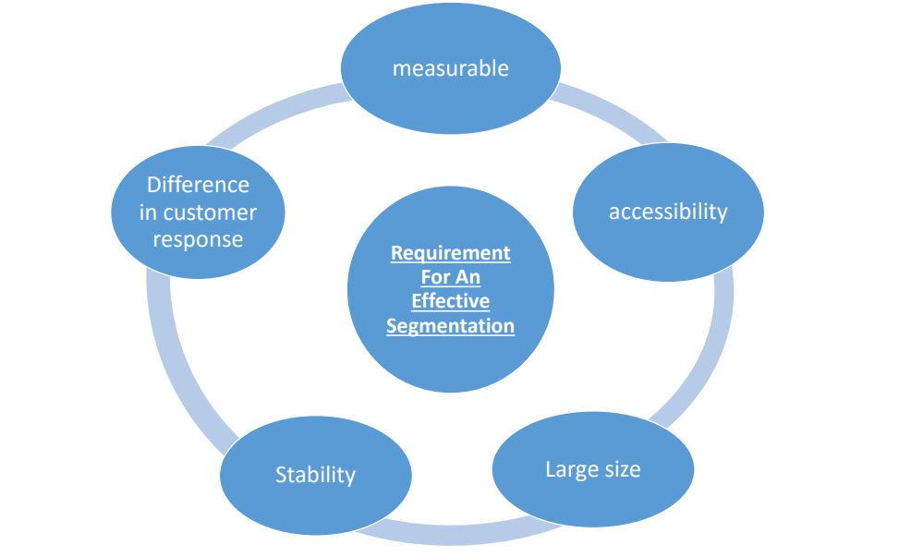

Slide 6
Bases for Segmenting the Consumer market
Segmentation
Customer Based Segmentation
Product Based Segmentation
Competition Based Segmentation
Geographic
Benefit Segmentation
Hard core Loyals
Demographic
Consumption Based
Soft core Loyal
Psychographic
Decision Criteria Based
Switchers

Slide 7
Geographic Segmentation
Classifying the market based on geographical locations and advantages.
Examples:
Metro Markets Non metro Markets
Urban & Rural Markets.
Zonal wise classification
Country wise classifications

Slide 8
Demographic Classification
Demography is the changing structure of the human population such as Age, income, education, gender ratio etc.

Slide 9
Psychographic
Psychographic segmentation is sometimes also referred to as behavioral segmentation.
Examples:
Lifestyle
Opinion, interest, hobbies
Degree of loyalty
Nature of usage of consumers etc

Slide 10
Product based Benefit segmentation
Direct benefit ( Personal usage benefit)
Derived benefit ( Gifting somebody etc)
Functional benefit ( expecting effective function)
Durability ( Expecting long life for product)

Slide 11

Targeting

Slide 12
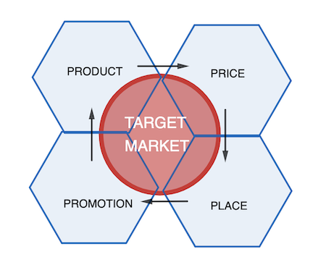
Meaning of Targeting
Targeting refers to selecting the specific segmented market group for implementing marketing efforts like developing product, pricing, promotion etc. It helps to focus only on selected segment and implement plans as per the convenience of the target customers.

Slide 13

Bases for identifying the target customers
Customer size. (Whether Large segment or niche market be focused?)
Stage of lifecycle of product to compete. ( whether to compete with new products/ existing products etc)
Competition: (Identify all competitors or only specific competitor)

Slide 14

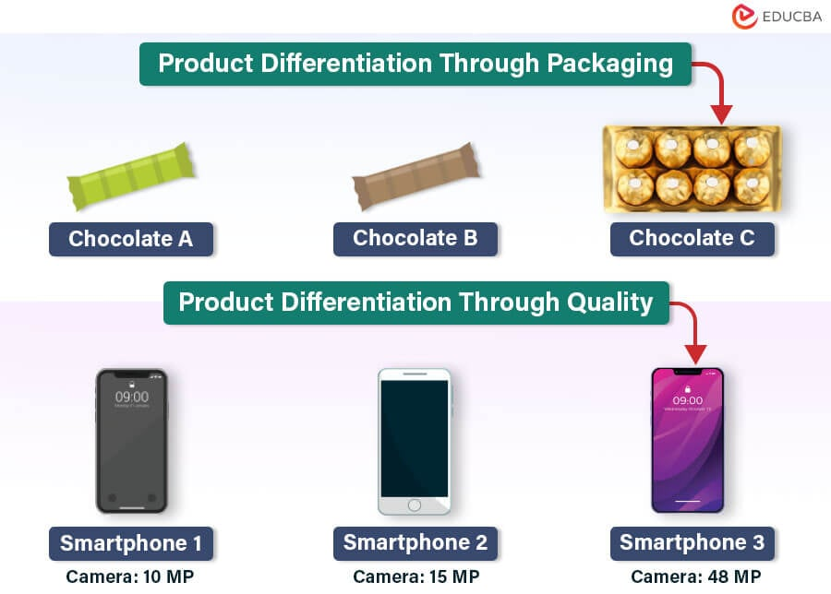

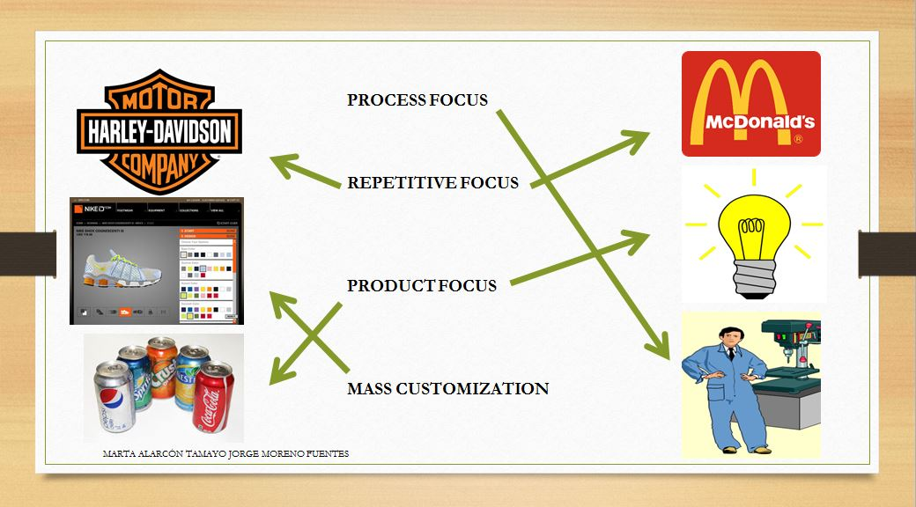
Targeting Strategies
Standardization strategy: Implementing the same product to all customers ( Coca-Cola, Pepsi etc).
2. Differentiation strategy: Company introduces different product and price strategies to different segments. Eg: Airlines.
3. Customization strategy.: Preparing product as per customer needs.
4. Focus Strategy: It is the combination of the two : Maruti suzuki, Dominos pizza etc.

Slide 15
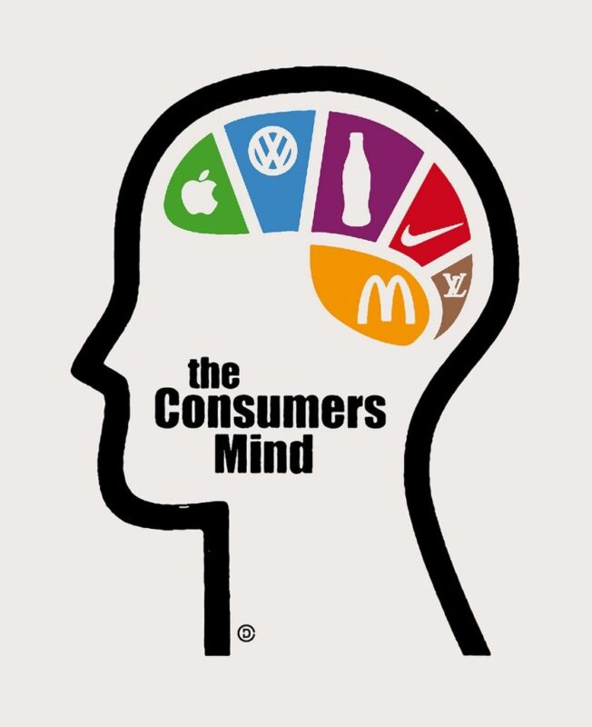
Positioning
Creating the image about the company and its product in the mind of the target customer is called positioning. It is the process of making the customer to accept the product in specific manner. Eg: Maruti cars are less maintenance and high mileage cars where as BMW are costly and high comfort cars. Nano is small and less priced car etc.

Slide 16
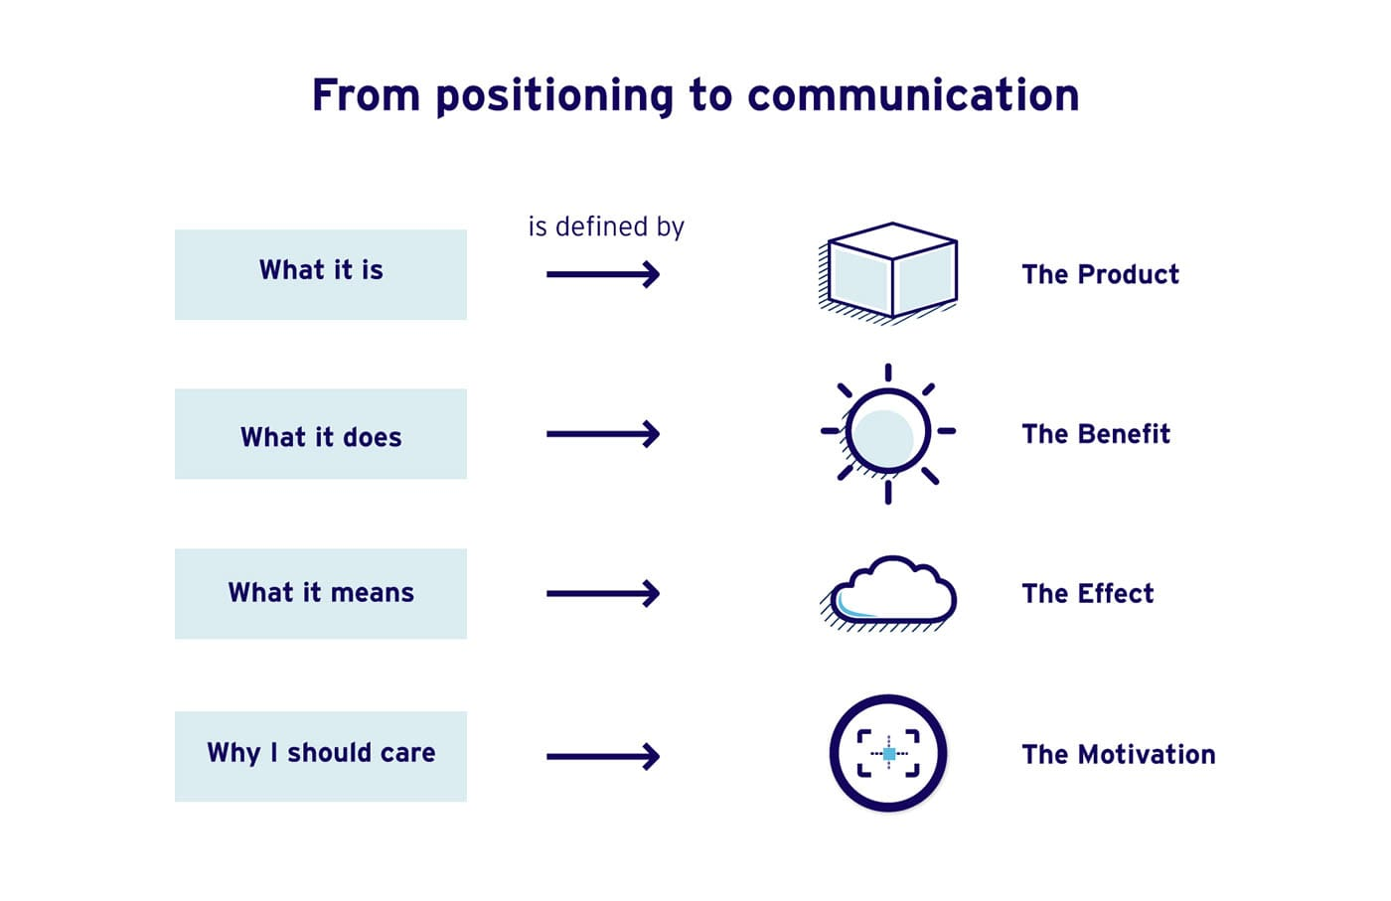
Positioning Differences are based on
Product.
Service
Channel
Price
People
Image

Slide 17
Examples of brand positioning
Amazon is positioned as low price quick delivary for consumer products where as Flipkart positioned as quality products in electronics
LinkedIn is much more of a corporate business and professional tool (today) – which has proven itself in the world of corporate recruiting while. Facebook is a huge social networking platform connecting millions over the globe.
Surf Excel offers outstanding stain removal ability on a wide range of stains. Keeps clothes clean and fresh with fragrance.

Slide 18
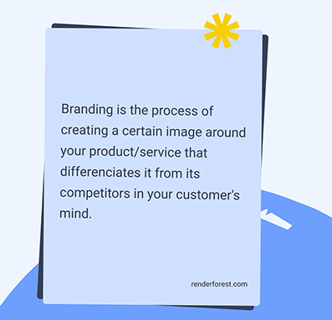
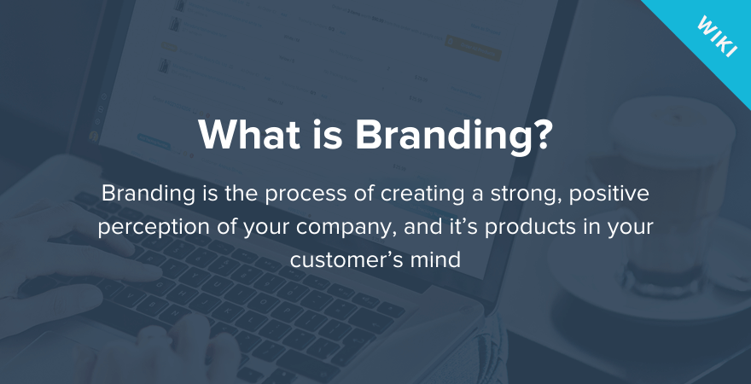
Branding
Concept of Branding
Brand Types
Brand equity
Branding Strategies

Slide 19
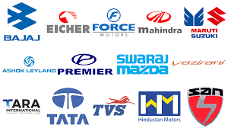
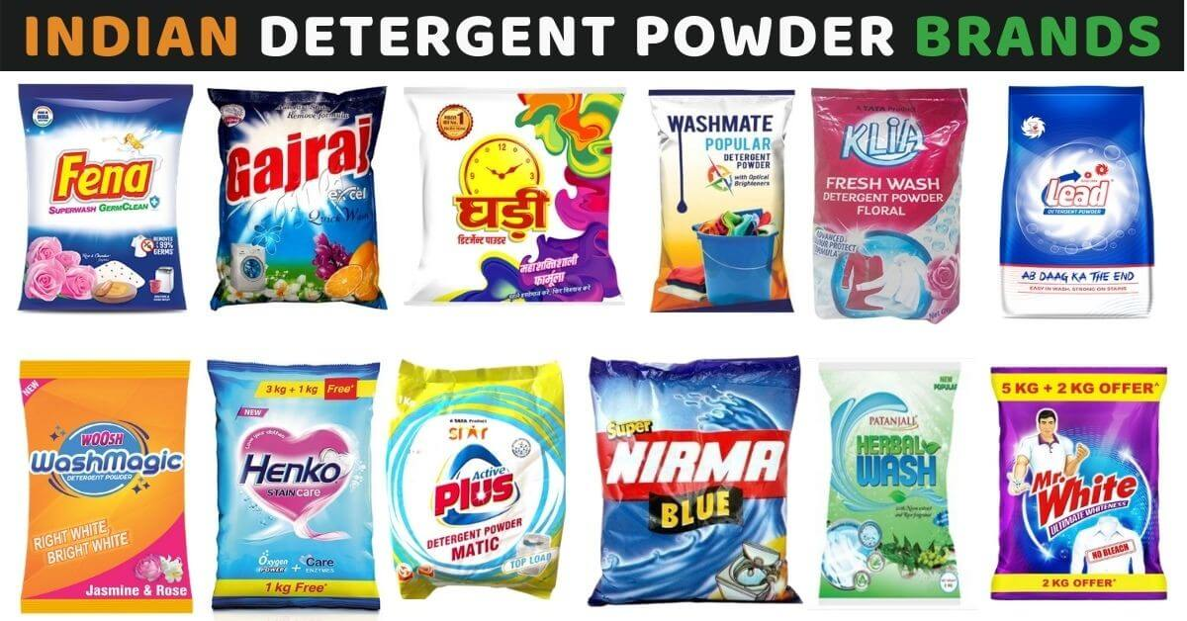
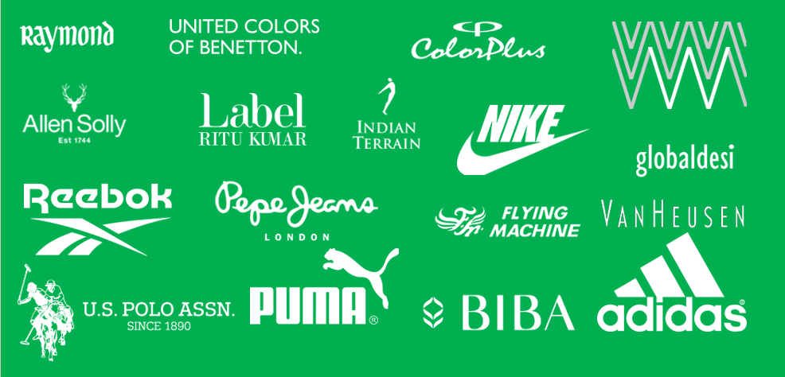


Slide 20



What is Brand
“A name, term, design, symbol or anyother feature that identifies one seller’s goods or service as distinct from those of other seller. If it is used for the whole firm it is called as trade name..”
American Marketing association
“A product with a personality.”
Chris Staples, Rethink, Vancouver
Marketing communications in any form has an impact on customers’ perceptions.

Slide 21
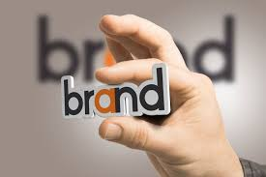
What is a brand ?
Branding is a combined effort of the company which is projected to the consumer.
Brand
Marketing
Company
Consumer
Design

Slide 22
Characteristics of strong brands
Brand can be valued in financial terms.
Brand can be bought and sold. ( it is an asset).
Customers develop emotional and intangible relation with the brand.
Entire company is concerned with brand.
Brand creates customer loyalty.

Slide 23
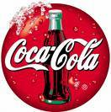

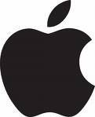

Brand Loyalty
“The degree of consumer attachment to a brand.”
Recognition
Awareness of name, benefit and package
Preference
Is useful, consumer will buy if available…evoked set
Insistence
Will search for; must have

Slide 24
The Role of Brands
Identify the maker
Simplify product handling
Organize accounting
Signify quality
Create barriers to entry
Serve as a competitive advantage
Secure price premium

Slide 25
Brand types
There are three types of Brands:
Functional Brand: These brands talk about functional values of product: Eg: Head and shoulder shampoo explain about how shampoo works on hair etc.
Image brands: It gives image to the user. Eg: Parker pen gives image of elite group. Cadbury/ Pepsi, Coca cola etc
Experience brands: Explain about the comfortability, different experience etc. Eg: Singapore Airlines: “ Fly our airline- enjoy 5 star experience in the sky. Café coffee Day.

Slide 26
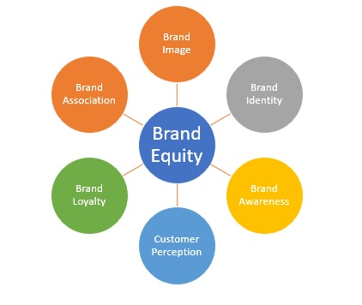
What is Brand Equity?
Brand equity is the added value endowed on products and services, which may be reflected in the way consumers, think, feel and act with respect to the brand.

Slide 27
What happens when brands have high equity?
The company can have more leverage with the trade
The company can charge a premium on their product
The company can have more brand extensions
The company can have some defense against price competition

Slide 28
Brand Strategy

Slide 29
Definitions of Brand Strategy
A plan for the systematic development of a brand to enable it to meet its agreed objectives.
The strategy should be rooted in the brand's vision and driven by the principles of differentiation and sustained consumer appeal.
The true brand is the sum total of the perceptions of all the constituencies which contribute to revenues and profits.

Slide 30
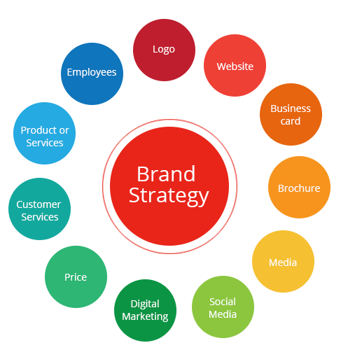
Components of Brand Strategy

Slide 31
Types of branding strategy
Normally, a company can opt for one or more of the following strategies:
Product branding
Product-line branding
Product-range branding
Corporate branding

Slide 32
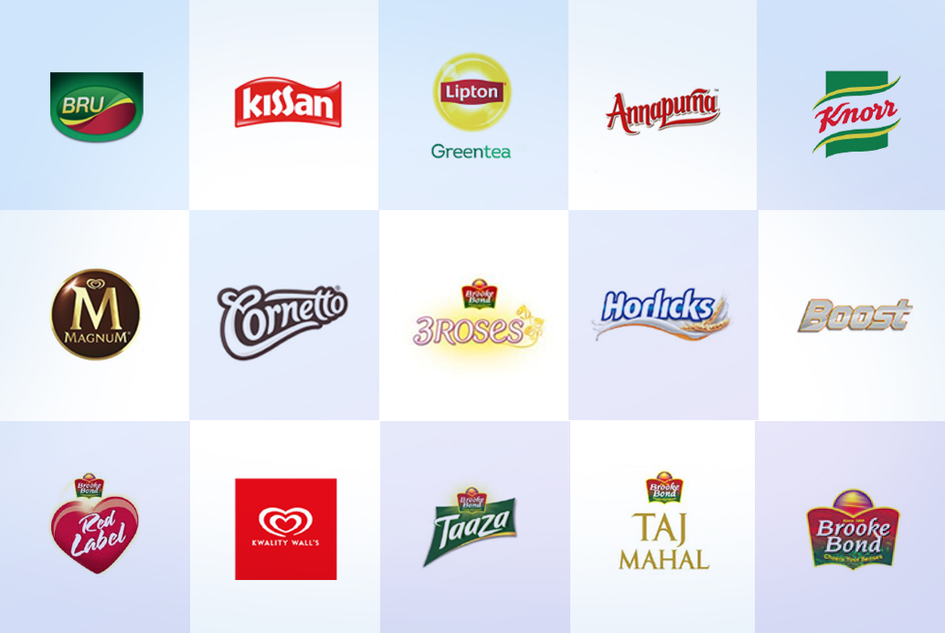
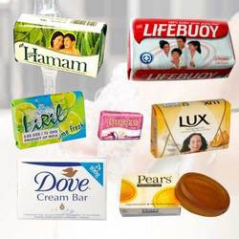
PRODUCT BRANDING STRATEGY
This type of brand give each individual product an exclusive brand name and the company name being ignored
It allows the brand to have unique values, personality, identity and positioning.
By doing so, it implies that every new product the company brings on to the market is a new brand and can be positioned precisely for a specific market segment
It has the advantage of making it easier for the company to evaluate brand performance and worth and allows better resource-allocation decisions.
The major drawbacks are product cannibalization if consumers cannot differentiate clearly among product brands and involves higher advertising and promotion budget and is totally self-supporting with little or not brand name assistance or assurance from the parent.

Slide 33
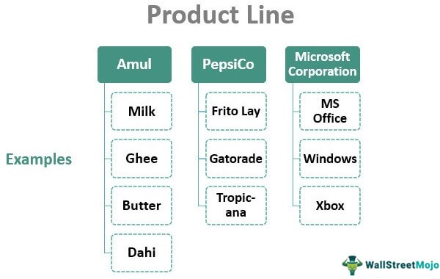
PRODUCT-LINE BRANDING STRATEGY
Here, the products appear under the same brand name and possess the same basic identity but with slightly different competencies for example Follow Me line of hair shampoos. Here the brand line comes under the hair-care category but the different line extensions cover complementary applications of essentially the same product.
Advantages therefore are economies of scale in advertising and promotion and each new line extension strengthens the position of the brand and therefore its image. The line helps defend the category from predatory attack. Hence, individual product brands can move across to line brands as companies find ways of extending the brand to different consumer groups or segments.

Slide 34
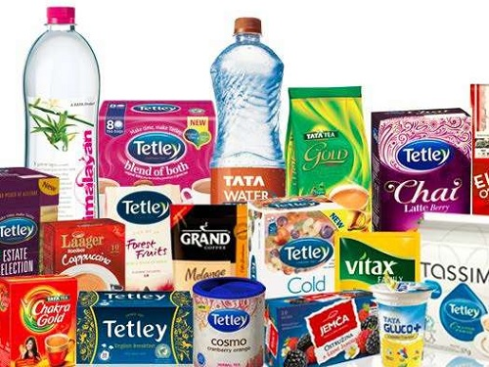
PRODUCT- RANGE BRANDING STRATEGY
A number of products or services in a broad category are grouped together under one brand name and promoted with one basic identity.
Compared to product-line branding, product-range branded products carry out the basically the same functions but at different performance levels like various cars in the Mercedes S, E, C and A class and Intel’s Pentium and Celeron ranges of microprocessors.
Therefore the advantage here is that a single brand name allows some economies of scale in advertising and promotion as the products tend to carry the same overall brand values and positioning.

Slide 35
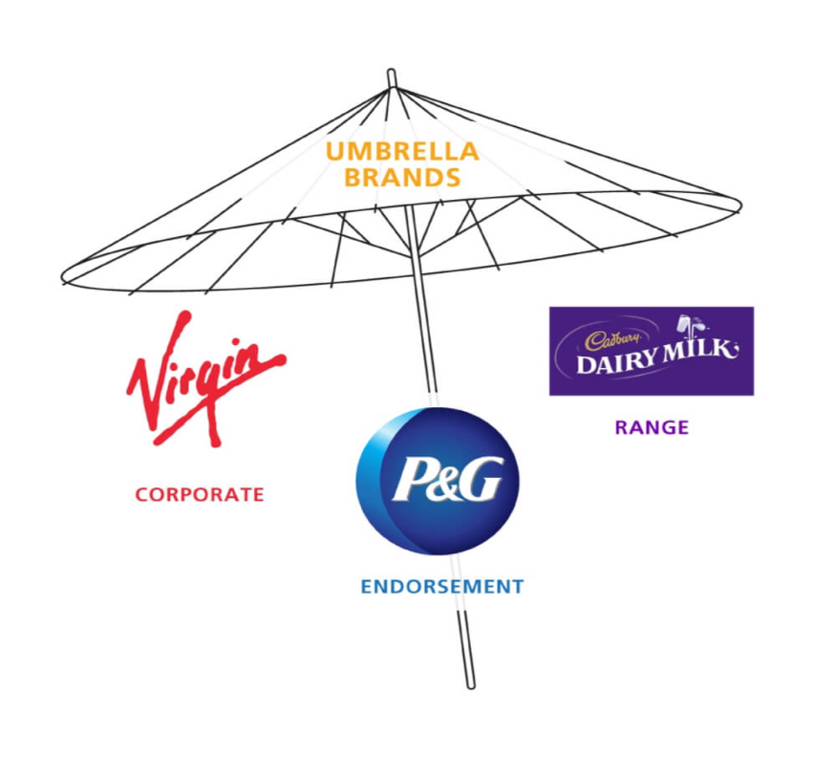
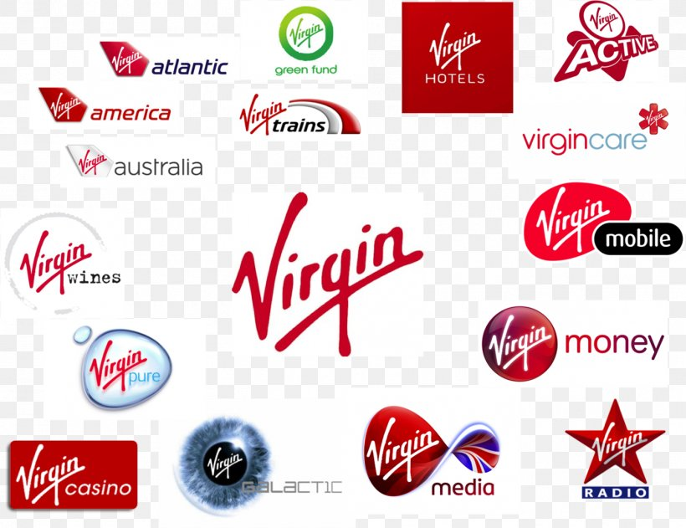
CORPORATE BRANDING STRATEGY/ Umbrella Branding strategy
Two approaches in the Corporate brand exercises
First is to promote its name as the main brand name sometimes referred to as monolithic or umbrella branding.
Here the product is not branded individually or as strongly as the corporate brand. Companies using this approach – IBM, Virgin, Sony.
The basic principle is that the companies believed that the company name is the life of an enterprise.

Slide 36
Thank You

